Slide 1
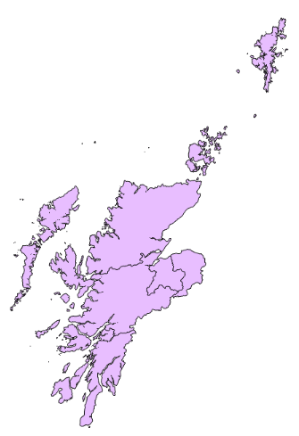
Shetland
Na h-Eileanan an Iar
Orkney
Caithness, Sutherland & Ross
Moray
Skye, Lochaber & Badenoch
Inverness & Nairn
Argyll & Bute

Slide 2
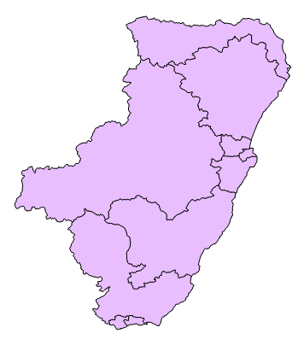
Banffshire & Buchan Coast
Aberdeenshire East
Aberdeen Donside
Aberdeenshire West
Aberdeen Central
Aberdeen South & North Kincardine
Angus North & Mearns
Angus South
Dundee City West
Dundee City East

Slide 3
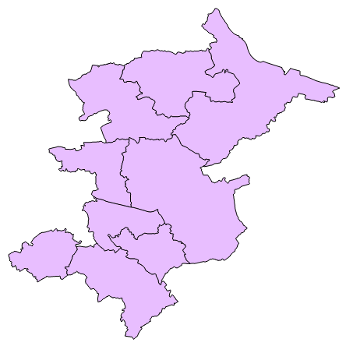
Falkirk West
Cumbernauld & Kilsyth
Falkirk East
Coatbridge & Chryston
Airdrie & Shotts
Uddingston & Bellshill
East Kilbride
Motherwell & Wishaw
Hamilton, Larkhall & Stonehouse

Slide 4
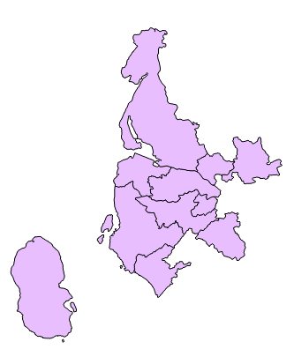
Clydebank & Milngavie
Dumbarton
Strathkelvin & Bearsden
Greenock & Inverclyde
Renfrewshire North & West
Renfrewshire South
Cunninghame North
Eastwood
Cunninghame South

